Slide 1
Welcome To My Presentation
Batch_46
Name_Bithi
Roll-19

Slide 2
“Reasons For Graduate Unemployment and It’s Effectiveness on Economic Growth”

Slide 3
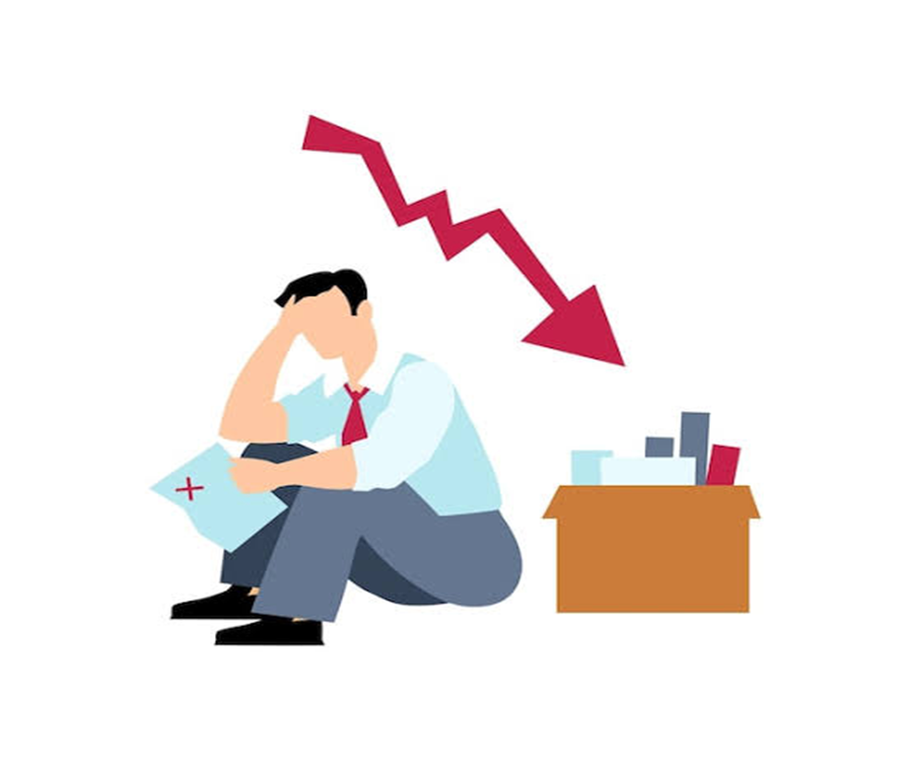

Slide 4
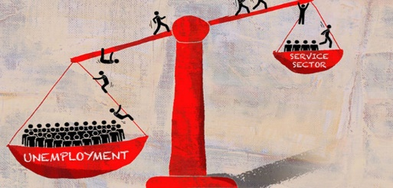
*Unemployment
According to The Organization for Economic Cooperation and Development (OECD), Unemployment is people above a specified age not being in paid employment or self-employment but currently available for work during the reference period. Nowadays unemployment is not only a national problem but also a common phenomenon of worldwide. Unemployment is taken as explanatory variable in this study.

Slide 5

*Economic Growth
Economic growth is an expansion in the production of goods and services compared from one period of time to another. The size of an economy is typically measured by the total production of goods and services in the economy which is called Gross Domestic Product (GDP). High unemployment generally has a negative impact on economic growth. Economic growth is taken one of the dependent variable in this study.

Slide 6

*Employment Rate
The employment rate is the percentage of employed person in relation to the comparable total population. The Organization for Economic Cooperation and Development (OECD) defines the employment rate as the employment-to-population ratio. This includes people that have stopped looking for work.
This Photo by Unknown Author is licensed under CC BY-NC

Slide 7
There are three main types of unemployment
Unemployment
Structural unemployment
Cyclical unemployment
Frictional unemployment

Slide 8
Structural unemployment: Caused by changes in the structure of the economy.
Cyclical unemployment: Associated with economic downturns and fluctuations in the business cycle.
Frictional unemployment: Result of voluntary employment transitions within an economy.

Slide 9

“Thank You”
This Photo by Unknown Author is licensed under CC BY-SA

